Slide 1
Collaborative Governance of Professionals and Organizations Serving Battered Mothers and Children
Kerry O’Brien Smith, M.P.S., Ph.D. Candidate
Virginia is for Children

Slide 2
The need for collaboration
Social problems demand leadership with best practices on how to tackle problems in communities.
Single leaders are not always able to meet the challenge of complex community problems
Collaboration can increase capacity to face challenges.
Applied collaborative governance theory brings public and private stakeholders together to participate in collaborative decision making processes (Ansell & Gash, 2008).
Collaborative governance combines practice and research in public administration (Emerson, Nabatchi, & Balogh, 2012).
Feminist scholars agree that states are generally patriarchal, in that, they act in the interests of men over women (Mirchandani, 2006).
In addressing battered mothers and children, collaborators must include Guardian ad Litems (GALs), custody evaluators, judges, attorneys, domestic violence (DV) and sexual assault organizations, and government agencies serving battered mothers (CPS, DSS, etc.).

Slide 3
Problem Statement
Domestic violence dynamics from relationships and marriages continue in legal proceedings as a means of maintaining power and control over victims (Watson & Ancis, 2013).
The cycle of abuse is perpetuated by family courts through child support hearings, custody and visitation litigation, intimidation/harassment, deliberately lengthening the case, particularly if the case is pro-father, manipulating finances, and distortions of information (Watson & Ancis, 2013).
Child custody and visitation arrangements provide a vehicle by which abusive men control women and their children, particularly in contested custody cases involving a history of domestic violence (Bancroft & Silverman, 2002; Butts, 1999; Lemon, 2000).
Despite popular belief, evidence shows that fathers who seek custody of children through litigation either obtain primary or joint legal custody (Supreme Judicial Court of Massachusetts, 1990).

Slide 4
Problem Statement
Judges and other actors, such as guardian ad litems (GALs) and custody evaluators, appointed to highly contested custody cases involving domestic violence to make decisions, recommendations, evaluations, or investigations, are generally uninformed regarding domestic violence and the cycle of abuse (Lemon, 1999; Family Violence Project of the National Council of Juvenile and Family Court Judges, 1995).
Several professional organizations have provided guidelines that discourage the granting of custody of minor children to perpetrators of violence against mothers (Family Violence Project of the National Council of Juvenile and Family Court Judges, 1995; American Psychological Association Presidential Task Force on Violence and the Family, 1996; Reihing, 1999).

Slide 5
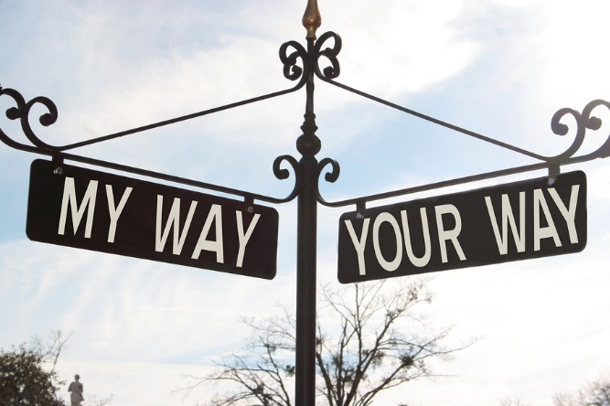
Problem Statement
The prevailing view in the child custody literature is that domestic violence and interpersonal violence (IPV) is primarily perpetuated by fathers (Bancroft & Silverman, 2002).
Family law is a central entity of concern for abused women due to the cross-section between criminal law and civil orders for protection (Cuthbert, et. al. 2002).
Abused mothers often face the prospect of having their children removed from them if they fail to protect children from abusive father, yet family courts order abused mothers to facilitate and encourage ongoing contact between the children and her abuser (Hannah & Goldstein, 2010).
Her failure to do so results in child custody being awarded to the abusive father.

Slide 6
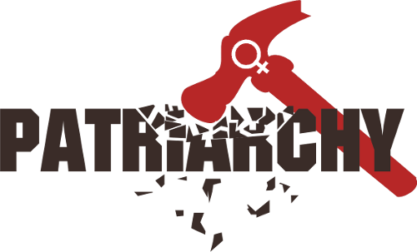
Problem Statement
U.S. family courts currently place priority on maximum contact with the male parent even if the mother warns the courts and appointed officials of the abuse (Stark, 2009).
Both Guardian ad Litems and custody evaluators are appointed to cases and they work independently and unilaterally while making recommendations that often separate nurturing mothers from often very young children, changing the social, legal, and economic dynamics of American families and communities without any collaborative guidance from experts in the domestic violence fields.
The treatment of battered mothers and their children in family courts in the U.S. is father-focused, patriarchal, biased, unilateral, uniformed, disjointed, and traumatic on the families, mothers, and children who seek protection.

Slide 7
Solutions
Collaborative governance may develop new methods by which family law cases involving domestic violence can be collaboratively managed to ensure the safety and protection of abused mothers and children.
Improving collaborative governance of family law cases involving contested child custody and domestic violence by removing unilateral professionals appointed to make recommendations with little to no background knowledge on domestic violence and providing a collaborative case management approach to battered mothers and children in these cases may reduce the incidences of child custody being awarded to abusive fathers.

Slide 8
Practical Implications of Collaborative Governance
Collaborative governance may:
Reduce incidences of child PTSD
Reduce revictimization of abused women
Strengthen maternal bonds between mothers and children
Serve as a validation for women that the abuse did occur (rather than suppressing it or ignoring it)
GALs, custody evaluators, and judges may become more knowledgeable about the dynamics of power and control in legal proceedings
Collaborative governance may:
Empower women to feel free to emancipate themselves from the continued cycle of power and control that the family courts statutorily place upon both abused mothers and children
reduce incidences of child deaths while living with abusive parent
reduce childhood trauma from being removed from the protective parent.

Slide 9
Creating a Foundation for Collaboration
Collaborative Mindsets in leadership
Lead a network
Use relationships, influence, media, peer pressure to achieve goals
Need strong relationships pulling in same direction to succeed
Flexibility
Shine a light on operations; show the public your work
You gain power by listening, speaking truth to those in power, making good on the promise, and delivering results.
“If you want to go quickly, go alone. If you want to go farther, go together.” African proverb

Slide 10
Common Collaboration Hurdles
Egos
Turf
Fear of losing control, autonomy, mission, resources, quality
Different cultures
Lack of trust or history of antagonism
Lack of resources or competition for resources
Power imbalances
No perceived reward for collaboration
Lack of time
Different goals among the parties
Silo mentality
Concern that exchange between parties will not be reciprocal

Slide 11
7 Key Collaborative Factors
Partners have shared, specific interest or purpose that they are committed to and can’t achieve (as well) on their own.
The partners want to pursue a collaborative solution now and are willing to contribute something to the effort.
The appropriate people are at the table.
The partners have an open, credible process.
The effort has a passionate champion (or champions), with credibility and clout.
The partners have trusting relationships.
The partners use the skills of collaborative leadership.

Slide 12
Who to Start Collaborations With
Domestic violence and sexual assault service nonprofit organizations
Guardian ad Litems
Custody Evaluators
Judges
Attorneys
CPS Social Workers
DSS Administrators

Slide 13
Strategies for Establishing High Commitment to the Project
Make the shared purpose real
Spell out, in clear terms, the cost of not acting
Ask each person what it will take to make it a priority
Find a senior leader who has strong interest in the project
Identify those on the team who are excited about project, assign important role or task
Build projects into chunks, celebrate small wins
Have collaborative leader demonstrate his/her passion for project
Connect project to larger value

Slide 14
Who to Invite to Collaborations
Represents an organization that has an interest in the issue, and can speak for that organization
Have expertise and knowledge related to the issue
Have a strong interest in issue
Can make the time to work on the team
Can bring resource to bear, if needed

Slide 15
Collaboration Ground Rules
Candor is essential; there is no retribution
Everybody contributes, and no one dominates
Egos, and agency identities, are left at the door
Differences are kept professional, not personal
The group uses 70% rule.

Slide 16
Five Qualities of Collaborative Leaders
Feel driven to achieve the goal through collaboration, with a measured ego.
Listen carefully to understand others’ perspectives.
Look for win-win solutions to meet shared interests.
Use pull more than push.
Think strategically; connect project to larger purpose.

Slide 17
Tasks in the First Few Collaborative Meetings
Shine a light on the problem or challenge.
Create an open, credible tone to build trust- discuss everyone’s interests and concerns
Discuss process for working together- decide on team norms, problem-solving approaches to use, and the way decisions will be made.
Develop project plan together, including steps, data, roles, criteria, and measures of success.
Play to partners’ strengths.
Invite members to take on additional tasks; describe how they will be accountable
Shine a light on successes, recognize contributions.

Slide 18
Five Strategies for Addressing Difficult Behaviors in Collaborative Projects
Communicate your expectations and needs
Use measurement, reward, and accountability systems that promote collaboration
Raise the stakes of the initiative
Check the roles (and role conflicts involved)
Use pull to deal with difficult personalities

Slide 19
Collaborating through Web 2.0 and Internet Resources
Self-organizing communities
Digital social media- engagement between stakeholders, employees, clients, and administration
Personal and professional networking
Participatory- more than information exchange, users are “co-creators” of content
Rich user experience
Can extent beyond Web sites, including mobile devices, podcasts, etc.
Constant evolution
Organized from the bottom up

Slide 20
Thank you!
For more information, please contact me: Kerry O’Brien Smith, kobriensmith@gmail.com
Virginia is for Children, https://www.facebook.com/Virginia-Is-For-Children-412192505582391/?fref=ts

Slide 21
References
Ansell, C. & Gash, A. (2008). Collaborative governance in theory and practice. Journal of Public Administration Research and Theory, 18, 4, 543-571.
American Psychological Association Presidential Task Force on Violence and the Family. (1996). Violence and the Family. Washington, DC: American Psychological Association.
Bancroft, L. & Silverman, J. (2002). The batterer as parent: Addressing the impact of domestic violence on family dynamics. Thousand Oaks, Calif: Sage Publications.
Butts-Stahly, G. (1999). Women with children in violent relationships: the choice of leaving may bring the consequence of custodial challenge. Journal of Aggression Maltreatment Trauma, 2, 239–251.
Cuthbert, C., Slote, K., Ghosh, Driggers, M., Mesh, C., Bancroft, L. & Silverman, J. (2002). Battered mothers speak out: a human rights report on domestic violence and child custody in the Massachusetts courts. Wellesley, Massachusetts: Wellesley Centers for Women. Available at https://www.wcwonline.org/Archived‐Projects/battered‐mothers‐testimony‐project.
Emerson, K., Nabatchi, T., & Balogh, S. (2012). An integrative framework for collaborative governance. Journal of Public Administration Research and Theory, 22, 1, 1-29.
The Family Violence Project of the National Council of Juvenile and Family Court Judges. (1995). Family violence in child custody statutes: an analysis of state codes and legal practice. Fam Law Quarterly, 28, 197–227.
Hannah, M. & Goldstein, B. (eds.) (2010). Domestic violence, abuse, and child custody: legal strategies and policy issues. Kingston: NJ: Civic Research.

Slide 22
References
Lemon, N. (1999). The legal system’s response to children exposed to domestic violence. Future Child, 9, 67–83.
Lemon, N. (2000). Custody and visitation trends in the United States in domestic violence cases. Journal of Aggression Maltreatment Trauma, 3, 329–343.
Linden, R. (2010). Leading across boundaries: creating collaborative agencies in a networked world. San Francisco: Jossey Bass.
Mirchandani, R. (2006). “Hitting is not manly”: Domestic violence court and the re-imagination of the patriarchal state. Gender & Society, 20, 6, 781-804.
Reihing, K. (1999). Protecting victims of domestic violence and their children after divorce: The American Law Institute’s model. Family Conciliation Courts Review, 37, 393–410.
Stark, E. (2009). Rethinking custody evaluations in cases involving domestic violence. Journal of Child Custody, 6, 3-4, 287 –
Supreme Judicial Court of Massachusetts. (1990). Gender bias study of the court system in Massachusetts. New England Law Review, 24, 745.
Watson, L. & Ancis, J. (2013). Power and control in the legal system: from marriage/relationship to divorce and custody. Violence Against Women, 19, 2, 166-186.

